Slide 1


Indian Government Dataset Analysis
Registration of Birth and Death(2021)
Dataset: Registration of birth and death
Email:rohithamadala2018@gmail.com
Phone:8897911844
LinkedIn: https://www.linkedin.com/in/rohithamadala/
GitHub: https://github.com/Rohitha1405/DataAnalytics-
Rohitha Madala

Slide 2

Late Registered Events categorized by gender (Male, Female, Transgender)
Introduction
The Registration of Birth and Death Dataset provides comprehensive insights into the vital statistics recorded across various taluks and districts. This dataset highlights the trends in birth and death registrations, focusing on:
Late Registered Events categorized by gender (Male, Female, Transgender)
Regional Distribution of birth and death registrations
Patterns and Trends across different demographic groups
This analysis aims to uncover key insights, identify potential factors influencing registration delays, and provide data-driven recommendations for improving registration efficiency.

Slide 3
Dataset Overview
The Registration of Birth and Death Dataset provides insights into late-registered events across various taluks/districts. The key features of the dataset are as follows:
🔹 Shape of Dataset: 236 rows and 9 columns 🔹 Regions Covered: Multiple taluks/districts (e.g., Chikkodi, Athani, Raibag, etc.) 🔹 Year of Data: 2021 🔹 Key Attributes:
Birth Registrations: Categorized by Male, Female, Transgender, and Total
Death Registrations: Categorized by Male, Female, Transgender, and Total 🔹 Focus Area: Late-registered events, indicating delays in official reporting of vital statistics

Slide 4
Initial Dataset Analysis
Identified unique taluks/districts and observed registration patterns for births and deaths
Loaded the Registration of Birth and Death Dataset and checked for missing values
Converted necessary columns to appropriate data types for consistency
Purpose of Analysis:
The analysis aims to:
Identify regions with high or low registration counts
Observe gender distribution trends in birth and death records
Highlight patterns that may indicate systemic delays or registration inefficiencies

Slide 5
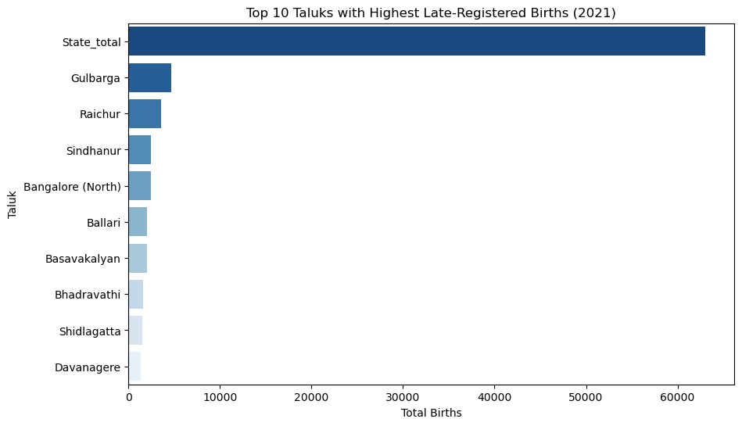
Top 10 Taluks with Highest Late-Registered Births (2021)
The plot shows the top 10 Taluks with the highest total births in 2021, highlighting regional birth distribution trends.

Slide 6
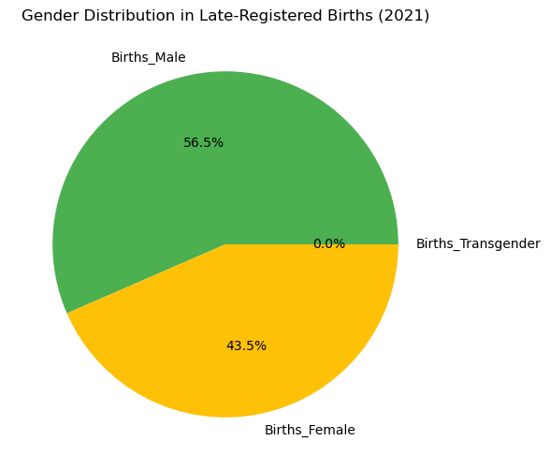
Gender Distribution in Births
Gender Distribution in Late-Registered Births (2021) in pie chart format highest births are observed as male compared female and others

Slide 7
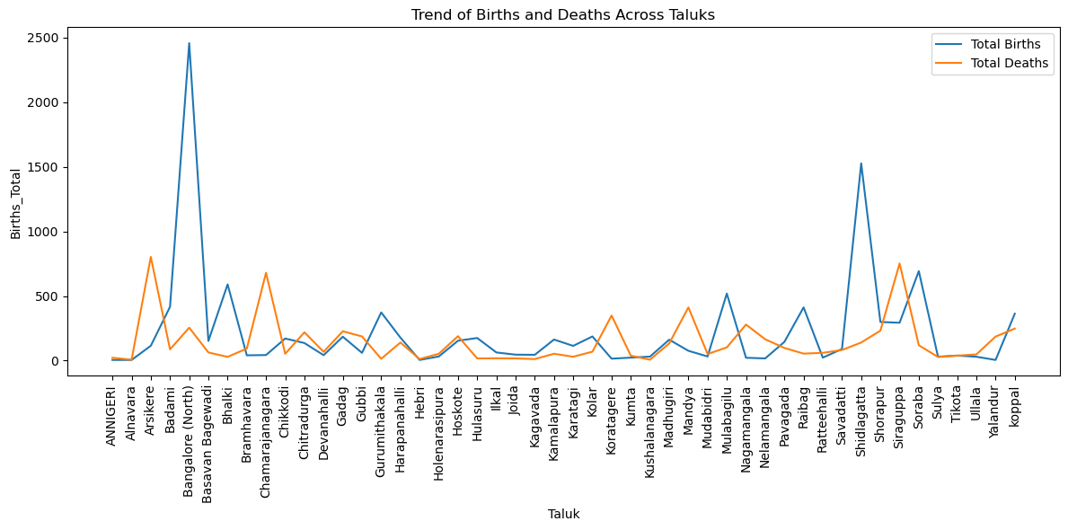
Trend of Births and Deaths Across Taluks
Above analysis talks about the total births in each taluk districts.

Slide 8
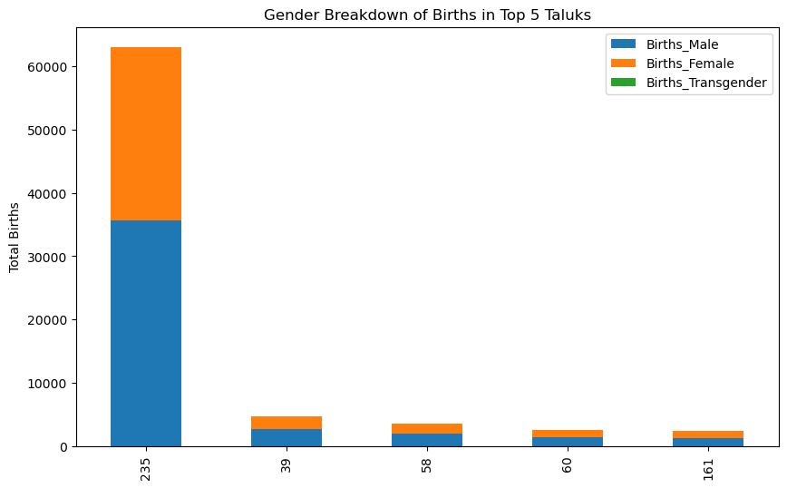
Gender Breakdown of Births in Top 5 Taluks
above analysis says about the birth of both male and female in top 5 taluk districts.

Slide 9
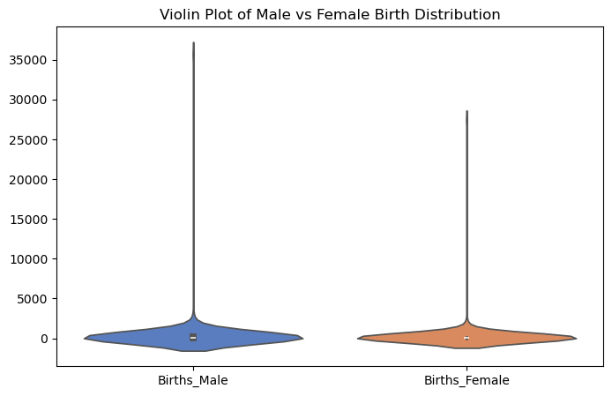
Violin Plot of Male vs Female Birth Distribution
The violin plot shows the clear representation of both Male and Female Births

Slide 10
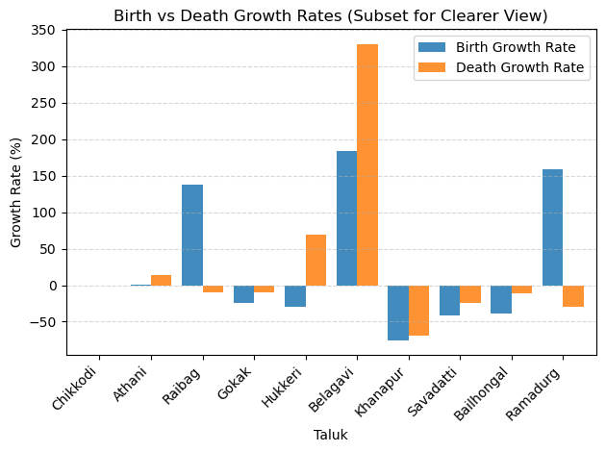
Birth vs Death Growth Rates
10 Taluk districts Birth and Death Growth Rate analysis

Slide 11
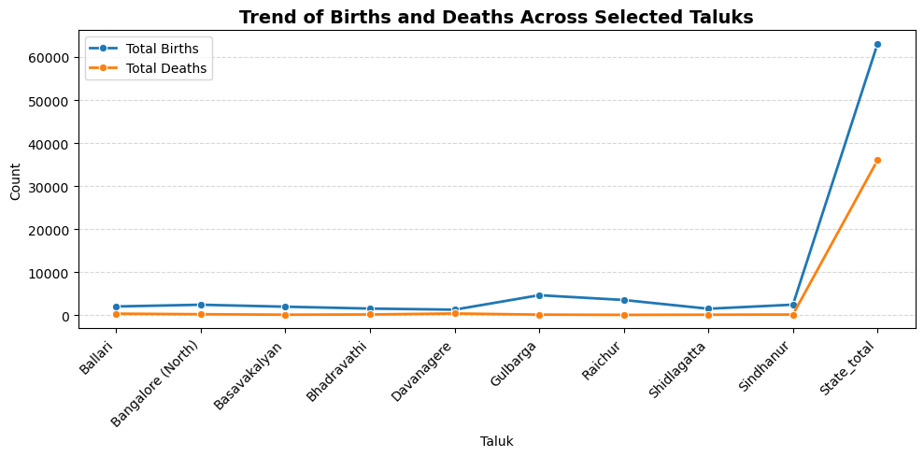
Trend of Births and Deaths Across Selected Taluks
These Births and Deaths across taluks shows the condition of a particular area

Slide 12
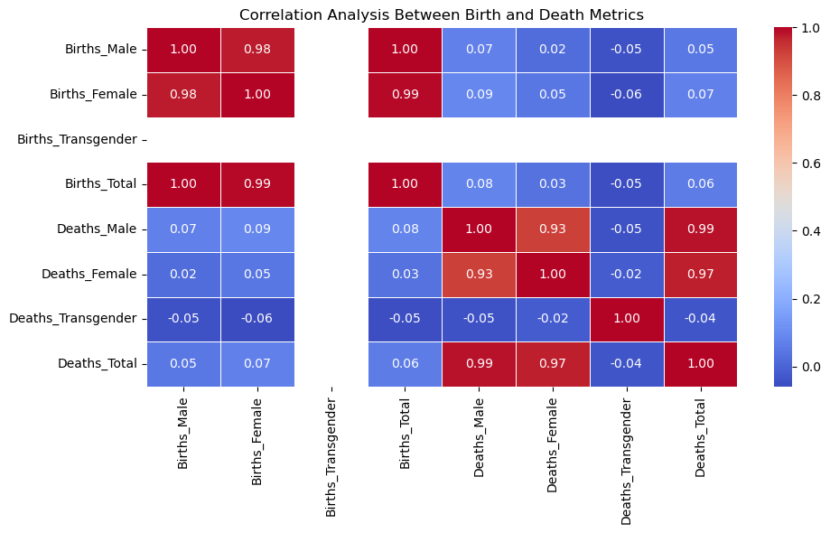
Correlation heap of Birth and Death Metrics

Slide 13

Line Plot: Showed fluctuating route distances while still revealing long-term trends.
Dataset Observations:
1.Handling Missing Values:
Missing route distances were effectively filled using the median value to prevent skewing the dataset. This ensured the data remained consistent without extreme fluctuations.
2.Data Type Verification and Conversion:
Numerical values were correctly formatted, and a new "Miles" column (1 km ≈ 0.62 miles) was added. This improved the clarity of distance-based insights.
3.Visual Insights:
Bar Plot: Identified Hubli as having the highest number of routes and total distance, emphasizing its significance as a major hub.
Box Plot: Exposed extreme route lengths in certain locations, indicating potential data anomalies or unique travel patterns.
Line Plot: Showed fluctuating route distances while still revealing long-term trends.

Slide 14
Scatter Plot: Demonstrated that a higher number of routes didn’t always correlate with longer distances, suggesting varied travel behaviors.
Pie Chart: Illustrated that a few prominent locations accounted for most of the total route distance, indicating concentration in specific regions.

Slide 15
Thank You…

